Slide 1
Is protein structure a molecular clock?
Revisiting structural divergence with AlphaFold, orthology and divergence times
An AI-led Phase 2 project of the Beltrao-lab agentic AI hackathon · [presenter] · [date]
Notes:
Title slide. Fill in presenter and date. The project was run end-to-end by Claude Opus 5.5 acting as PI, delegating to Opus/Sonnet subagents.

Slide 2
Disclosure: every result here was produced by AI
!
Exercise in assessing the bioinformatics capabilities of agentic AI (Beltrao-lab hackathon, github.com/evocellnet/ai-hackathon).
Executed by Claude Opus 5.5 with Opus/Sonnet 5.5 subagents, within a 48 h compute cap (48 CPUs, 500 GB RAM, 1 A100).
Results have not yet been verified by a human. This is not a traditional publication.
Repository: [link to project repository] · Report: technical report/report.md
Notes:
Human-written disclosure required by the hackathon. Keep on screen briefly.

Slide 3
The hackathon
1
Can an AI agent run a bioinformatics project from prompt to paper?

Slide 4
A week-long test of agentic AI in bioinformatics
Beltrao lab
2 phases
15
ETH Zürich
Phase 1: 'predict X' tools
Phase 2: open discovery
Phase-1 tools listed (pockets, docking, orthology, kinases, MS…)
Colm Ryan lab
UCD
Claude
[__]
Emanuel Gonçalves lab
Opus 5.5 as PI agent, delegating to Opus/Sonnet subagents
participants · [dates] · [Euler cluster details]
IST
Christophe Dessimoz lab
Humans verify methodology and benchmarking afterwards; each repository opens with a human-written disclosure.
UNIL
Notes:
From the hackathon README: run by the Beltrao (ETH Zurich), Ryan (UCD), Goncalves (IST) and Dessimoz (UNIL) labs. Claude ran each project with minimal human intervention; humans verify afterwards. Blanks: dates, participants, compute details beyond this project.

Slide 5
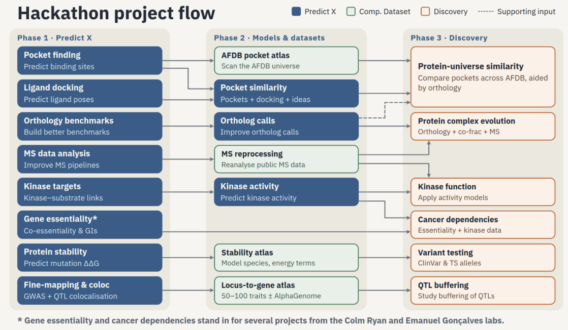
From prediction tools to discovery projects
This project
Phase 2 discovery: does protein 3D structure evolve like a clock?
Built on
Ancestra (Phase-1 orthology tool) + AlphaFold DB clusters (Foldseek) + TimeTree
Notes:
The attached project-flow diagram. Phase 1 built tools (blue); Phase 2 built models and datasets (green); Phase 3 discovery (orange). This project is a Phase 2 discovery project on structural evolution; it consumed the Phase-1 orthology tool Ancestra and public AFDB-cluster resources.

Slide 6
The prompt
2
One generic research scaffold + one project-specific question

Slide 7
The prompt has two layers
Shared by all projects
Specific to this project
PI role
Design by critique
Revisit Elofsson 2009
AFDB clusters 2023
plan, delegate, review, decide
literature → design → ≤3 review rounds
linear, 3–10× more conserved?
evolution never analysed
Reproducibility
Memory
Use Ancestra
Neutral clock?
seeds, DATA.md, git, no hard-coding
research tree + lessons file
orthologs vs paralogs
comment on structure
Verification
Report
Ideas (priors)
Budget
toy data, controls, non-author review
paper-style, disclaimer, figures
LDO, kinases, cytoskeleton
48 h, node move at 12 h
Notes:
Left: generic instructions shared by all hackathon projects. Right: what is specific to this project. The project ideas in the prompt were explicitly 'human priors, not a plan'.

Slide 8
Two goals, five questions
Goal 1 · Is structure a molecular clock?
Goal 2 · AFDB clusters in the light of evolution
1
Shape: linear or saturating vs sequence?
5
Duplication: do paralogs diverge more in structure?
2
Ratio: how much slower than sequence?
6
Do structural clusters match ortholog groups?
3
Time: same ratio on young and old branches?
7
Case studies: cytoskeleton & kinases
4
Lineages: structure-specific rates?
Notes:
Goal 1 is the confirmatory core (pre-registered endpoints E1–E5). Goal 2 is open-ended; the duplication test E6 doubles as a positive control.

Slide 9
24 hours of wall clock, two compute nodes
Scouting
literature, data, Ancestra, env
Ancestra
180 proteomes, 5 h
Tuning
20% of families
Verify
re-derive 42/42 · refute
Node 1 · 10.9 h
Node 2 · ~12 h
Design
3 review rounds
Pairs
1.4 M pairs × 3 alignments
Freeze → confirm
once, 80%
Report
+ review
Node move at 20:30 on day 1 (checkpointed); resumed from the research tree on day 2.
Notes:
Node 1 (10.9 h): scouting, design, panel, Ancestra, pair metrics, tuning part 1. Node 2 (~12 h): tuning part 2, dry run, single confirmation run, verification, post-hoc review, report. Total compute ~23 h of the 48 h cap.

Slide 10
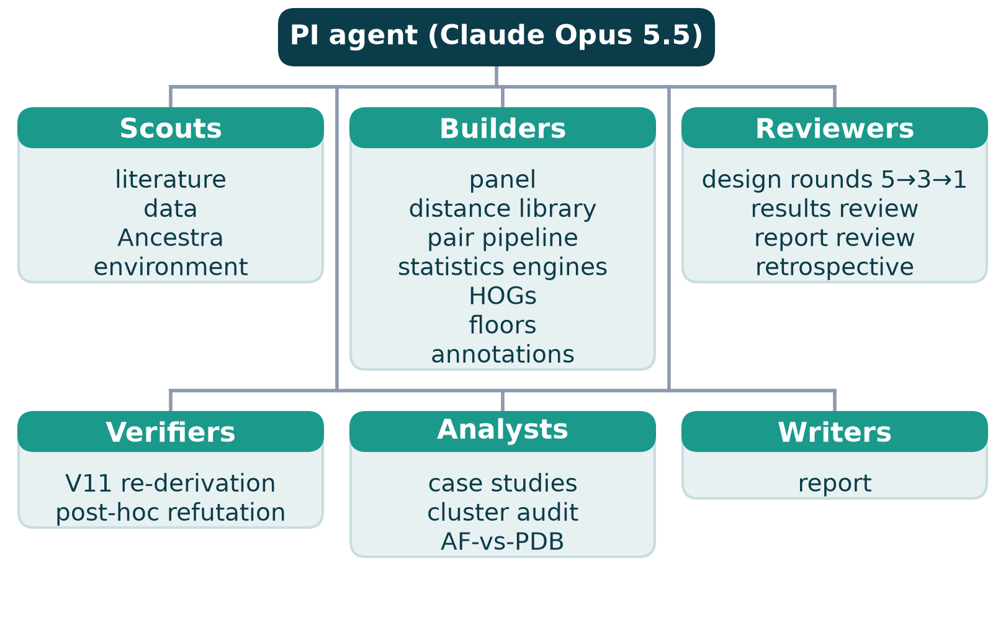
An AI research team: one PI agent, many specialists
≈40
subagent tasks with written reports
13
independent reviews (design, results, report, retrospective)
85+
git commits: every decision traceable
Notes:
Roughly 40 subagent tasks across scouting, building, reviewing, verifying, analysing and writing. The PI read written summaries only, keeping its own context lean.

Slide 11
How the method was decided
3
Scout → design → independent critique → pilot → freeze

Slide 12
Scouting first: four agents in parallel
1
2
3
4
Literature
Data
Orthology
Compute
Elofsson 2009 used substitutions, not time → a time test is new
Cluster pairs are pre-filtered by structure → biased toward plateau
Ancestra: 148/149 Ensembl orthologs; duplication timing only 36% right
Foldseek GPU works; dated trees reliable for eukaryotes only
→ Design choices: eukaryote panel with dated tree · orthologs chosen by sequence only · never trust duplication ages · measure the AlphaFold bias
Notes:
Design was written only after four scouting reports. Each changed the design: time had never been the axis; in-cluster pairs are biased; TimeTree is eukaryote-centric; Ancestra orthologs are reliable but duplication timing is not.

Slide 13
Design by independent critique: 5 → 3 → 1 reviewers
✓
Branch lengths on the dated species tree replace pair medians
Round 1
Round 2
Round 3
✓
Pre-set decision rules (equivalence margins) replace AIC/BIC
Every reviewer had to propose concrete changes within scope, or say none were needed.
✓
Positive control (duplication) + power checks
✓
Tune on 20%, confirm once on 80%; Holm correction
✓
Noise floors; errors-in-variables correction
Notes:
Round 1: external PI, molecular evolution, statistics, algorithms/compute, AI failure modes. Round 2: external PI, statistics, molecular evolution. Round 3: consistency check that produced the executable ANALYSIS_PLAN.

Slide 14
Pilots on real data caught what reviewers missed
8 / 104
identical-sequence pairs got non-zero AA distance under TM-align
Decision D22
primary alignment → Foldseek 3Di+AA; TM-align and sequence-only kept as brackets
Lesson
no reviewer predicted it; a small real pilot did
Notes:
Running the full pipeline on a 20-species test set, before any endpoint, showed that TM-align (the planned primary alignment) mis-aligns residues of close relatives and gives non-zero distance to identical sequences. Decision D22: switch to Foldseek 3Di+AA alignment; keep TM-align as sensitivity.

Slide 15
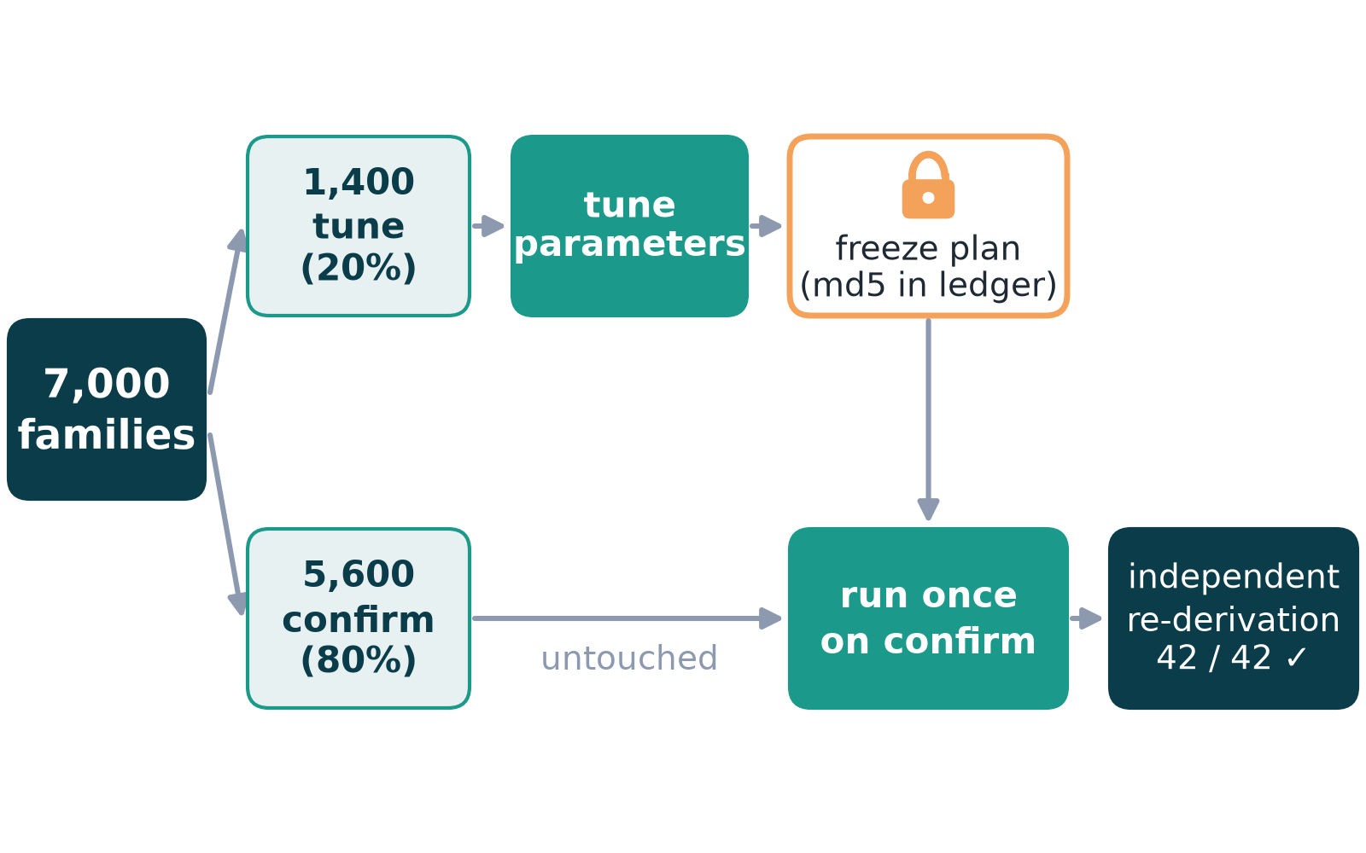
Pre-registration: tune on 20%, confirm once on 80%
10/10
automated guards passed before the single confirmation run
34
logged deviations (32 before confirmation)
42/42
numbers re-derived by a non-author agent
Notes:
The confirmation script refuses to run unless plan, tuning file and family split match their checksums in the results ledger, the git tree is clean and an explicit flag is set. Every change to the plan is logged with reason and effect (34 entries).

Slide 16
Key decisions and why
Decision | Why
Use only proteins whose AlphaFold model sequence = UniProt sequence | sequence and structure must describe the same molecule
Never use Ancestra's duplication ages | only 36% agreement with Ensembl
One Ancestra run on 180 whole proteomes | per-cluster runs would cost thousands of CPU-hours
3Di+AA alignment as primary (D22) | TM-align failed the identical-sequence check
Fix two estimator biases found in simulation (D31, D32) | both would have produced false positives
Keep pre-set margins even when power was low | never change tests to make results look better
Report post-hoc reinterpretation separately, after independent refutation attempt | a fixed noise floor turned out incomplete
Notes:
Each row links to DEVIATIONS.md / RESEARCH_TREE.md.

Slide 17
The method, step by step
4
With plain-language explainers for the tricky parts

Slide 18
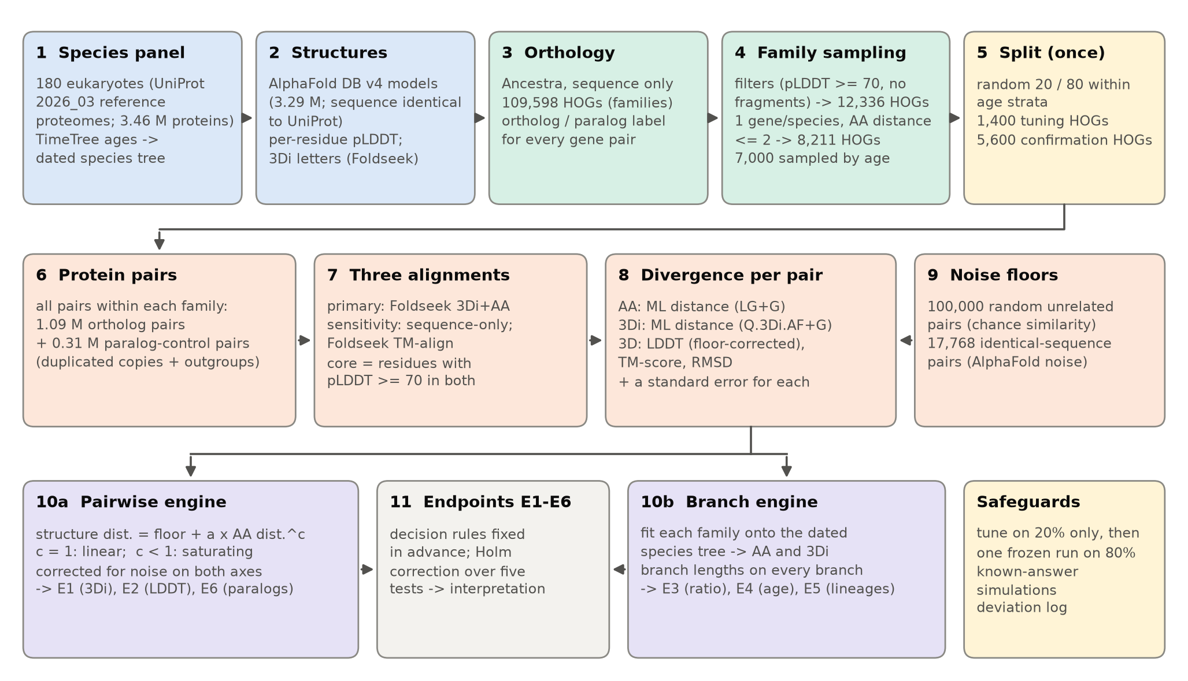
Pipeline at a glance
Notes:
Species panel → AlphaFold structures → orthology (Ancestra) → family sampling and split → three alignments per pair → amino-acid, 3Di and 3D distances → noise floors → two estimation engines → six pre-registered endpoints.

Slide 19
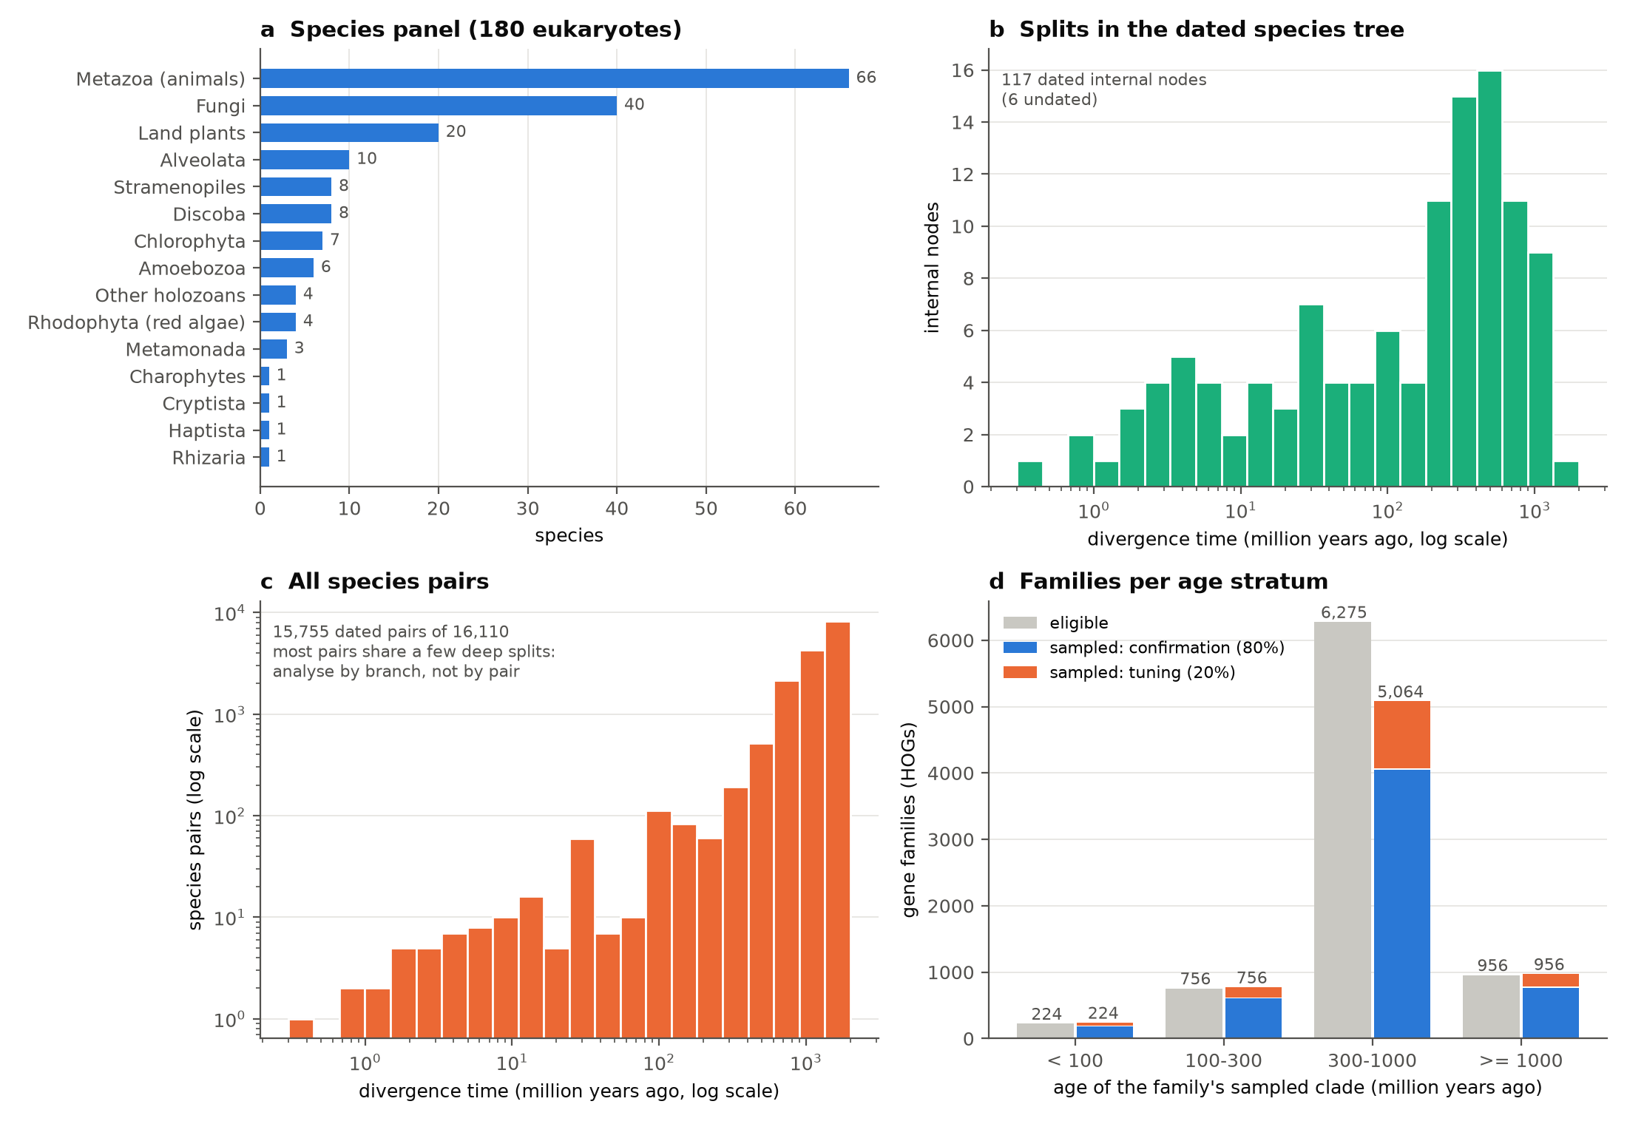
Data: 180 eukaryotes, 3.3 M predicted structures
180
eukaryotic proteomes (66 animals, 40 fungi, 20 plants, 54 protists…)
109,598
ortholog families (HOGs) from Ancestra
1.4 M
protein pairs from 7,000 sampled families
Notes:
Panel selected for AlphaFold v4 coverage (≥80% identical sequences), BUSCO completeness, TimeTree dating, and an even spread of split ages; 100 prokaryotes for case studies only.

Slide 20
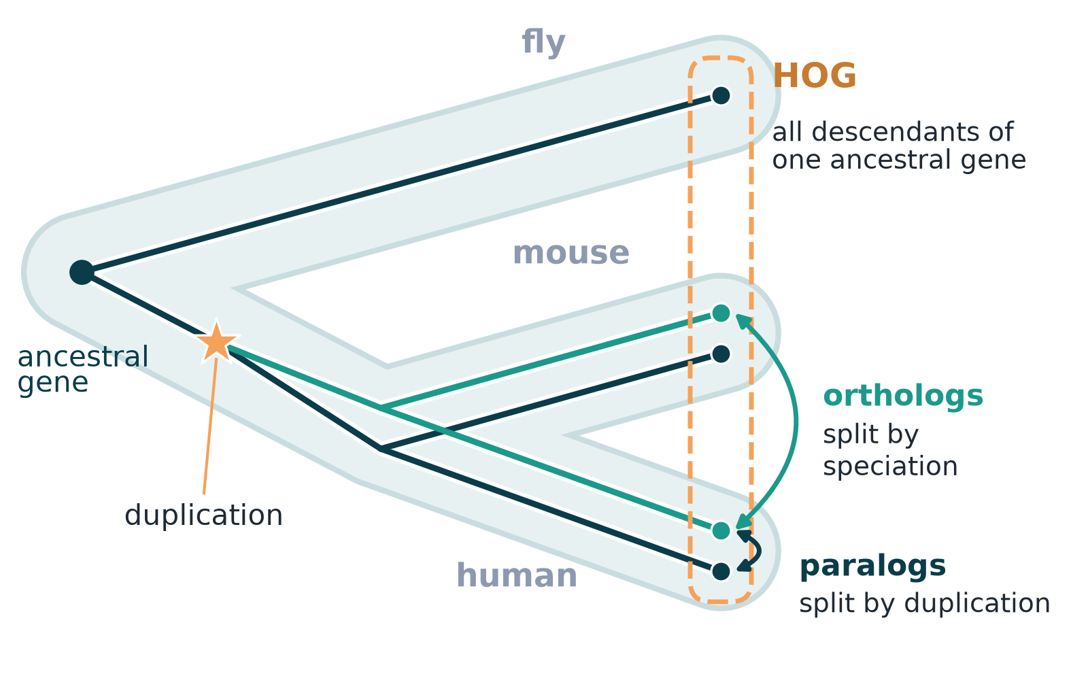
Explainer: orthologs, paralogs and HOGs
Ortholog
split by speciation → age known from the species tree
Paralog
split by duplication → age unknown
Why it matters
orthologs give a clean clock test
Notes:
Orthologs: separated by speciation (same gene in two species). Paralogs: separated by duplication. A HOG gathers all descendants of one ancestral gene. Only orthologs have a split time we can read from the species tree.

Slide 21
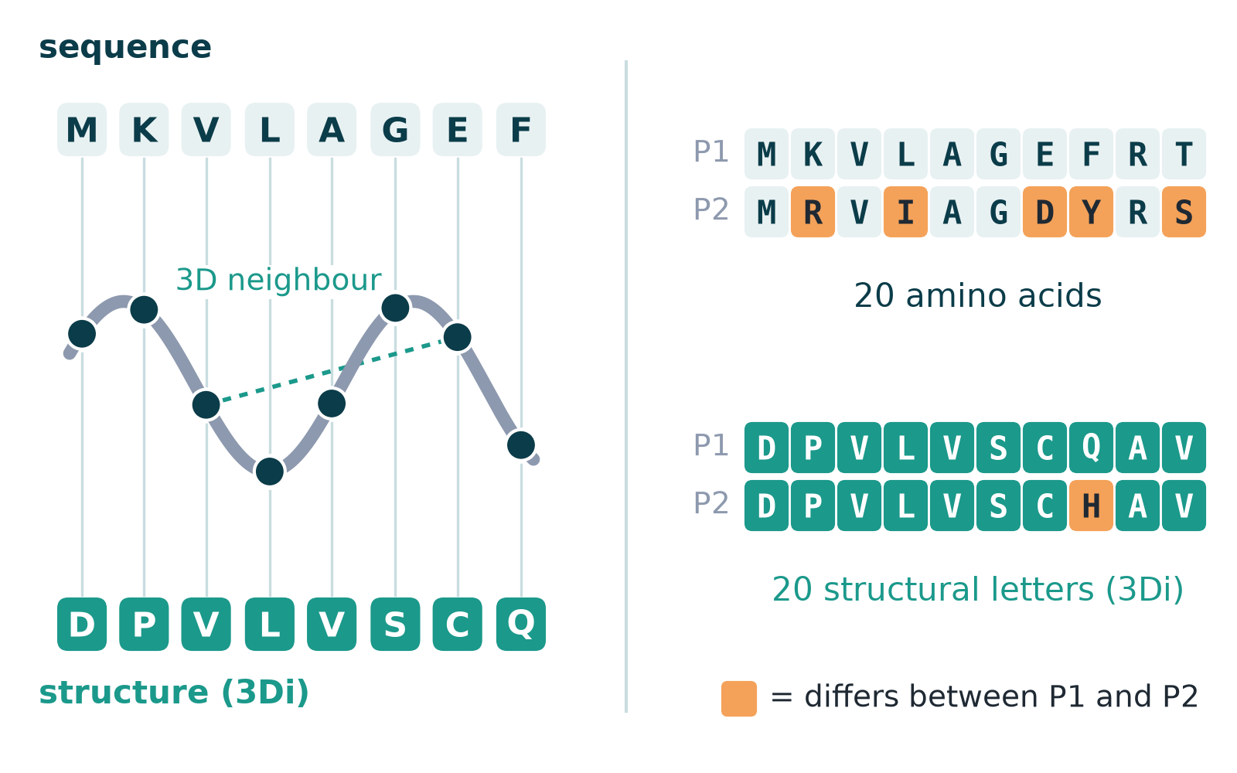
Explainer: AlphaFold models and 3Di letters
20 vs 20
amino acids vs structural letters: a like-for-like comparison
pLDDT ≥ 70
only confidently predicted residues used
Illergård 2009
had to approximate this by grouping amino acids
Notes:
Foldseek turns each residue's local 3D contact geometry into one of 20 letters (3Di). Proteins become two strings of equal alphabet size, so structure and sequence change can be counted with the same machinery.

Slide 22
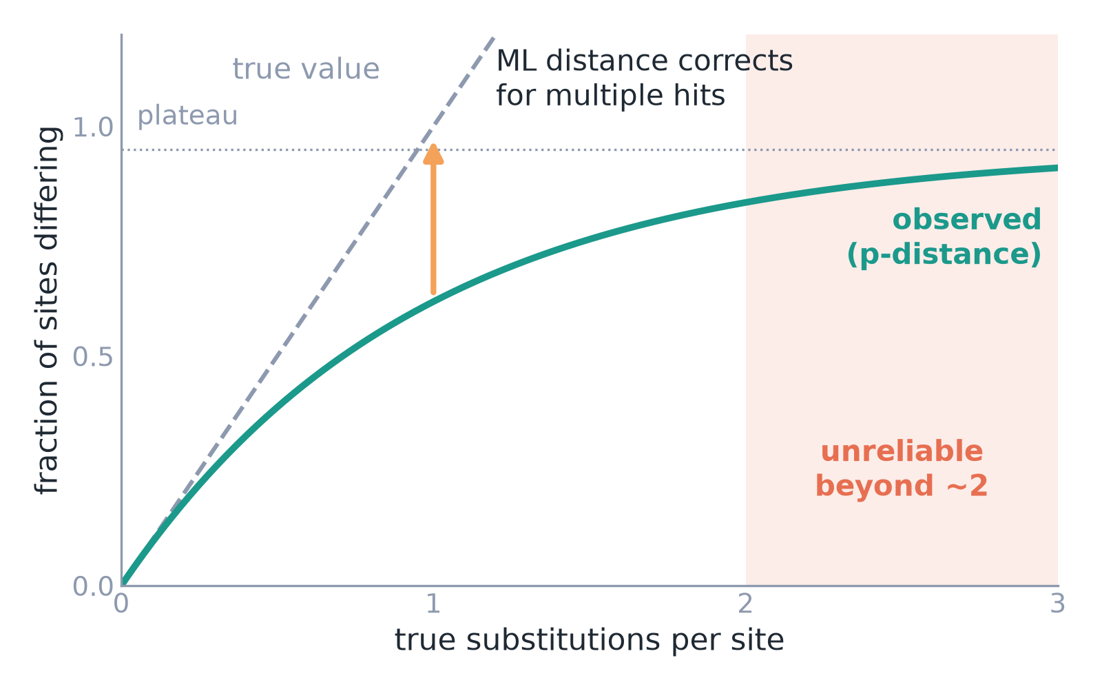
Explainer: counting change when changes overlap
ML distance
expected substitutions per site, corrected for multiple hits
Validated
unbiased within 1.6% on simulated data; matches IQ-TREE within 0.004%
Notes:
Raw percent difference saturates because sites change more than once. A maximum-likelihood (ML) distance with a substitution model (LG for amino acids, Q.3Di.AF for 3Di) estimates substitutions per site; beyond ~2 it becomes unreliable, so families were restricted to ≤2.

Slide 23
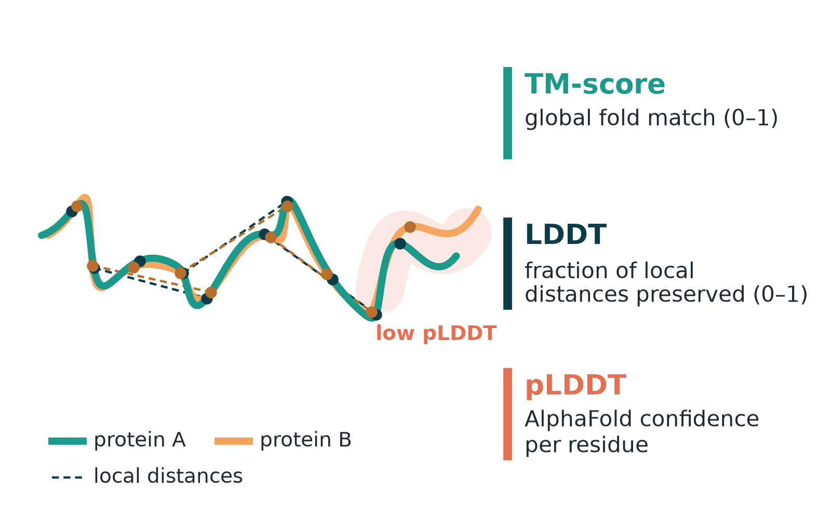
Explainer: three ways to compare two structures
0.95
median TM-score between AlphaFold models of identical sequences: predictions are not identical
0.052
3Di distance at zero sequence change (prediction noise floor)
Notes:
TM-score: global fold match. LDDT: fraction of local inter-residue distances preserved. 3Di distance: substitutions in the structural alphabet. All are measured only over confidently predicted residues.

Slide 24
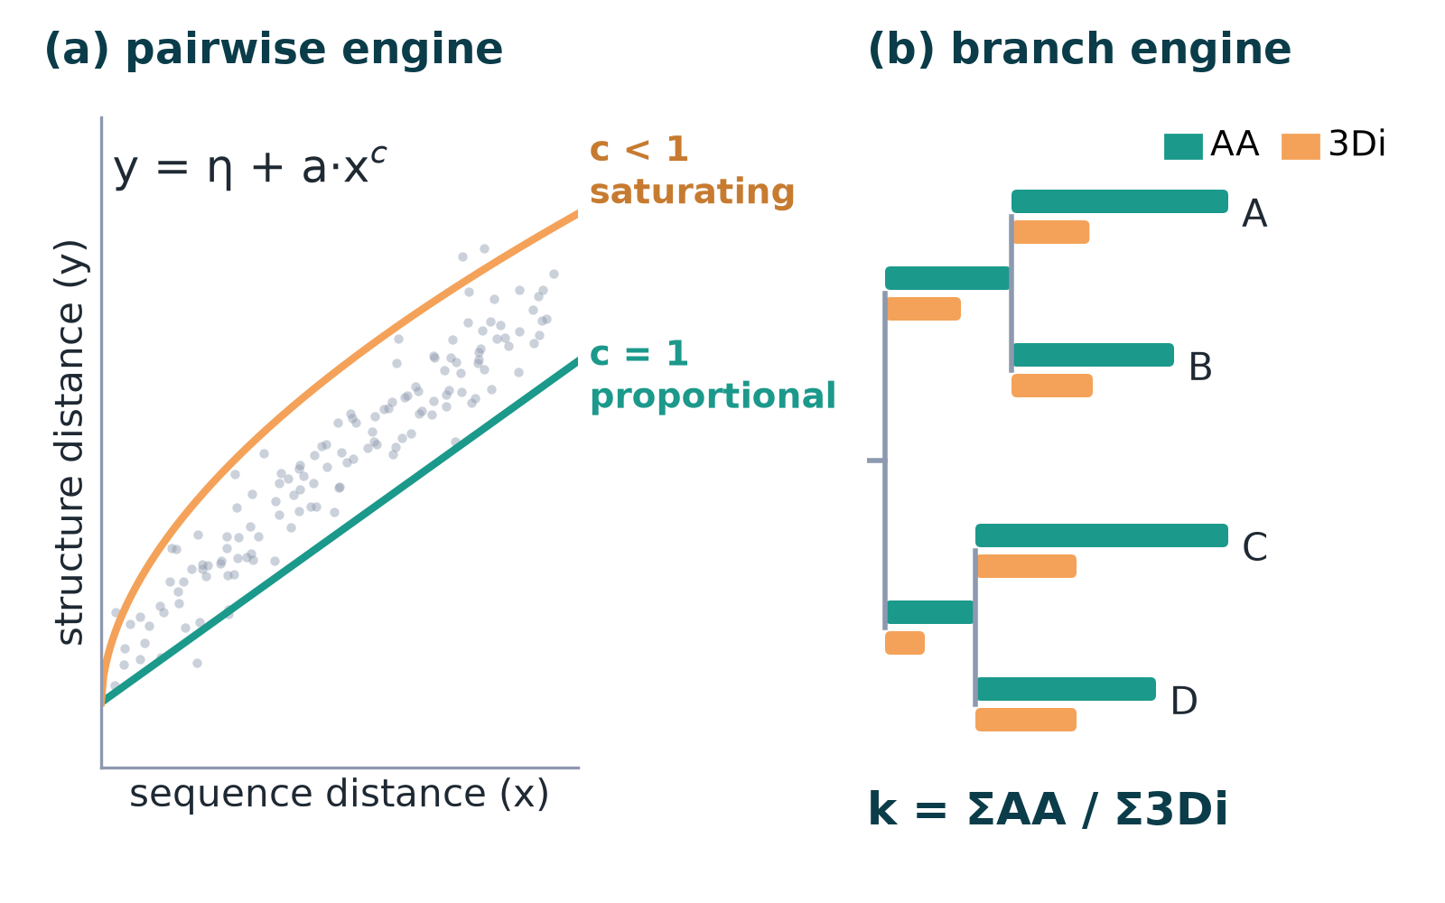
Explainer: two estimation engines
Shape
curvature c from pairs (E1, E2)
Ratio · time · lineage
branch lengths on the species tree (E3–E5)
Notes:
Pairwise engine: fit structure distance = floor + a·(sequence distance)^c; c = 1 means proportional, c < 1 saturating. Branch engine: place each family's distances on the dated species tree, giving an AA length and a 3Di length for every branch; ratios of sums give k.

Slide 25
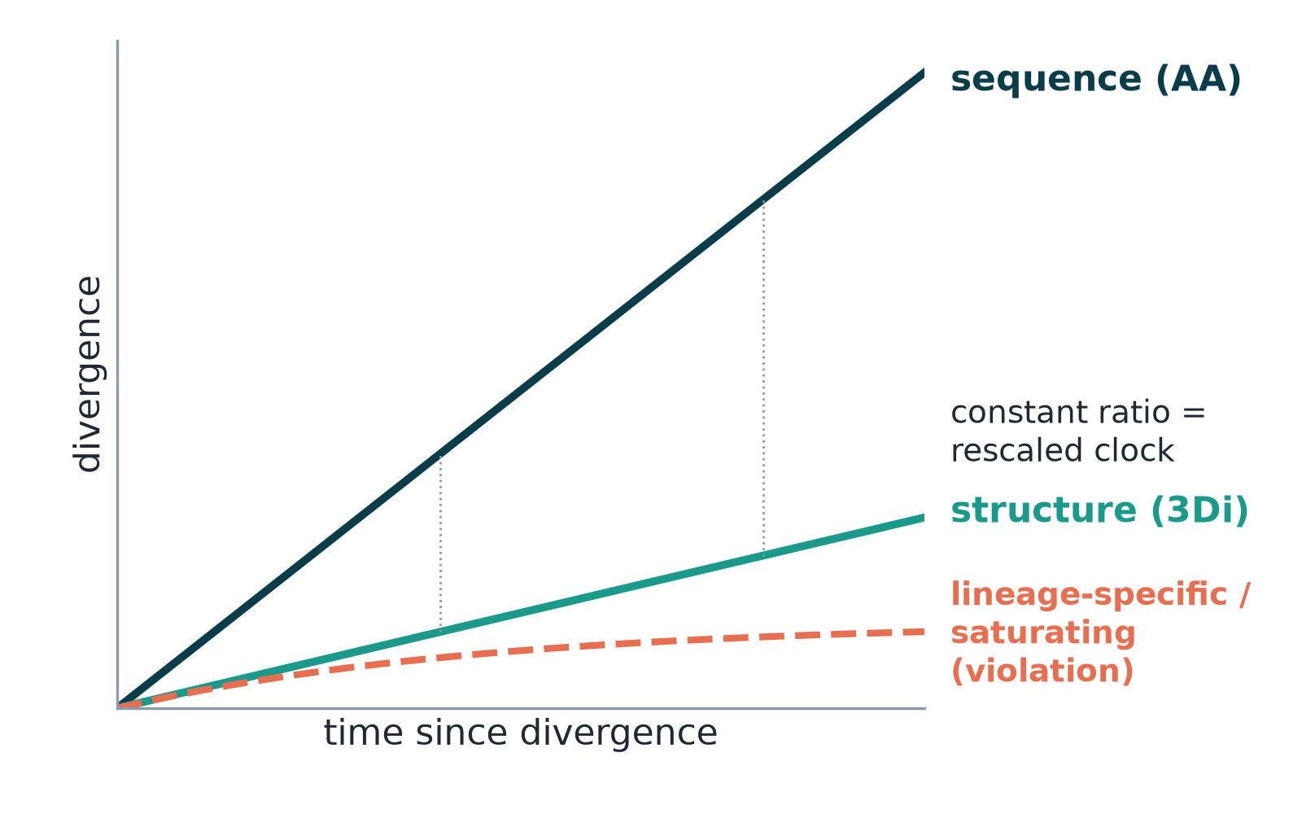
Explainer: molecular clock and the neutral null
Proportional
constant 3Di/AA ratio across ages and lineages
Violation
ratio drifts with age, or some lineages change structure faster
Notes:
Clock: change accumulates in proportion to time. Neutral structural null (N0): structure changes only as a passive by-product of sequence change, one constant ratio per family across lineages and ages. A good fit would show 'proportional', not prove 'neutral'.

Slide 26
How this differs from previous approaches
Study | Pairs | Divergence axis | Structure measure | Scale / focus
Illergård et al. 2009 | SCOP domain pairs (PDB) | substitutions | core states / RMSD | ~hundreds of families
Pascual-García et al. 2019 | superfamilies (PDB) | substitutions | structural distances | clock violations vs function
Barrio-Hernandez et al. 2023 | AFDB, 214 M models | none (cluster LCA) | Foldseek clustering | no rate analysis
Moi et al. 2025 (FoldTree) | families (AFDB) | tree topology | 3Di + AA distances | phylogenies
Warwick Vesztrocy et al. 2025 | paralogs (AFDB) | branch lengths | Foldseek LDDT | least-diverged ortholog
This project | orthologs, 180 eukaryotes | TimeTree ages + ML | 3Di (Q.3Di.AF), LDDT, TM | 7,000 families, pre-registered
Notes:
Commonalities: all relate structural to sequence divergence. Differences: this project selects pairs by orthology only, uses a real time axis, matched 20-state alphabets, and pre-registration at AFDB scale.

Slide 27
The hypotheses, one by one
5
Each with: what it is, prior literature, pros and cons of our test, and the verdict

Slide 28
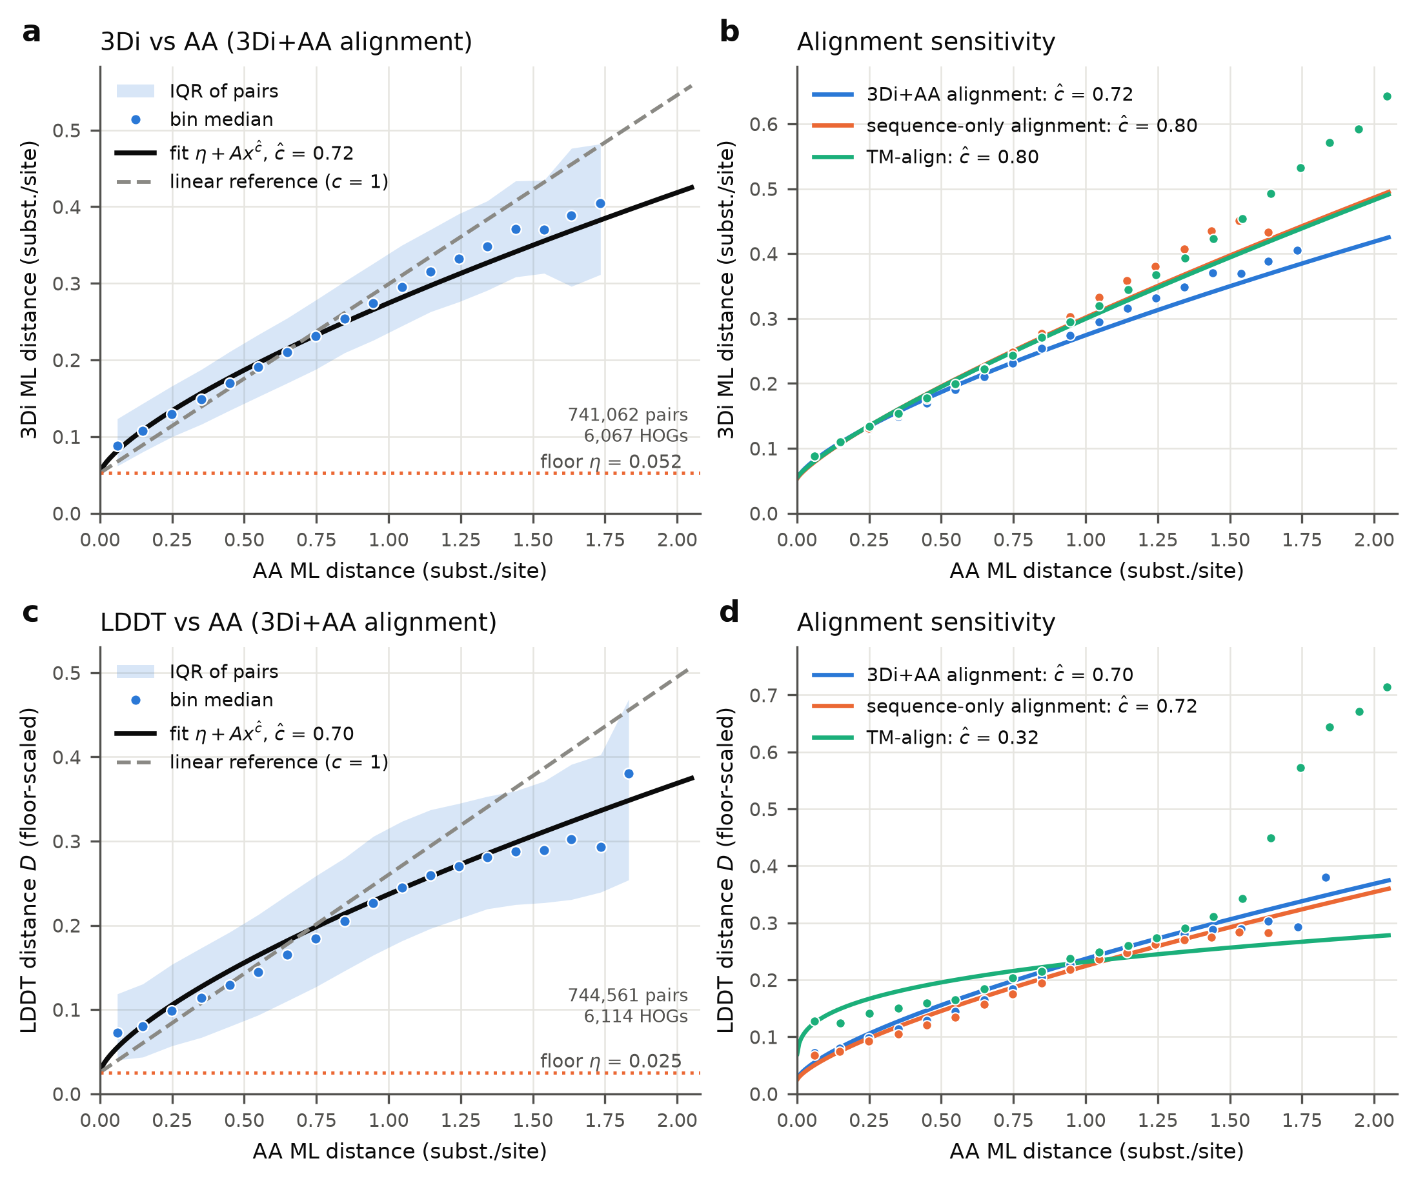
H1 · Shape: does structure diverge linearly with sequence?
Prior work
Chothia & Lesk 1986 (exponential vs identity); Koehl & Levitt 2002; Illergård et al. 2009 (linear vs ML distance).
+ Pros
− Cons
orthology-selected pairs
matched 20-state models
errors-in-variables correction
3 alignments
per-model AlphaFold noise biases toward concave
mild curvature hard to detect
Pre-registered
Concave: ĉ = 0.72 [0.64–0.80], robust to alignment
Post hoc (verified)
Curvature bracketed 0.75–1.0; moves toward 1 in high-confidence models
3Di (and LDDT) distance vs amino-acid distance across ortholog pairs; curvature c = 1 is linear.
Notes:
E1/E2. The pre-registered estimator assumed a fixed noise floor. A per-protein offset (~0.01–0.017) biases it toward concavity (synthetic truth c=1 → 0.75–0.78).

Slide 29
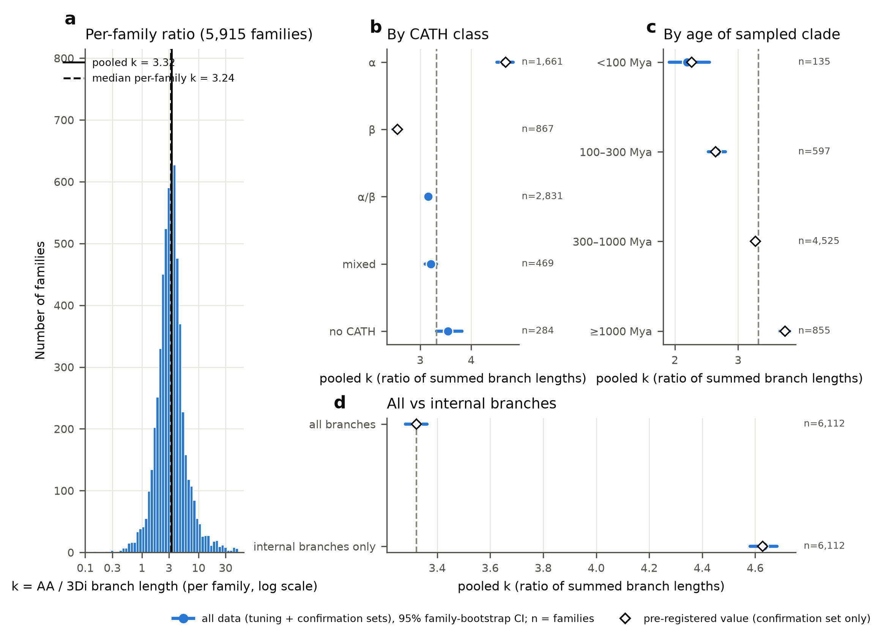
H2 · Is structure 3–10× more conserved than sequence?
Prior work
Illergård et al. 2009: 3–10× after alphabet matching (15–30× with raw states); β faster than α.
+ Pros
− Cons
true 20 vs 20 comparison
branch-level sums on the species tree
4,891 families
specific to 3Di and predicted structures
terminal branches inflated by noise
Pre-registered
k = 3.3 [3.09–3.57]; α 4.7× vs β 2.6×
Post hoc (verified)
Internal branches: k = 4.6; α 6.1× vs β 3.9× (gap persists)
k = total amino-acid change / total 3Di change over tree branches.
Notes:
E3. The plain-language reading: for every 4–5 amino-acid substitutions per site, about one residue's local 3D-contact letter changes.

Slide 30
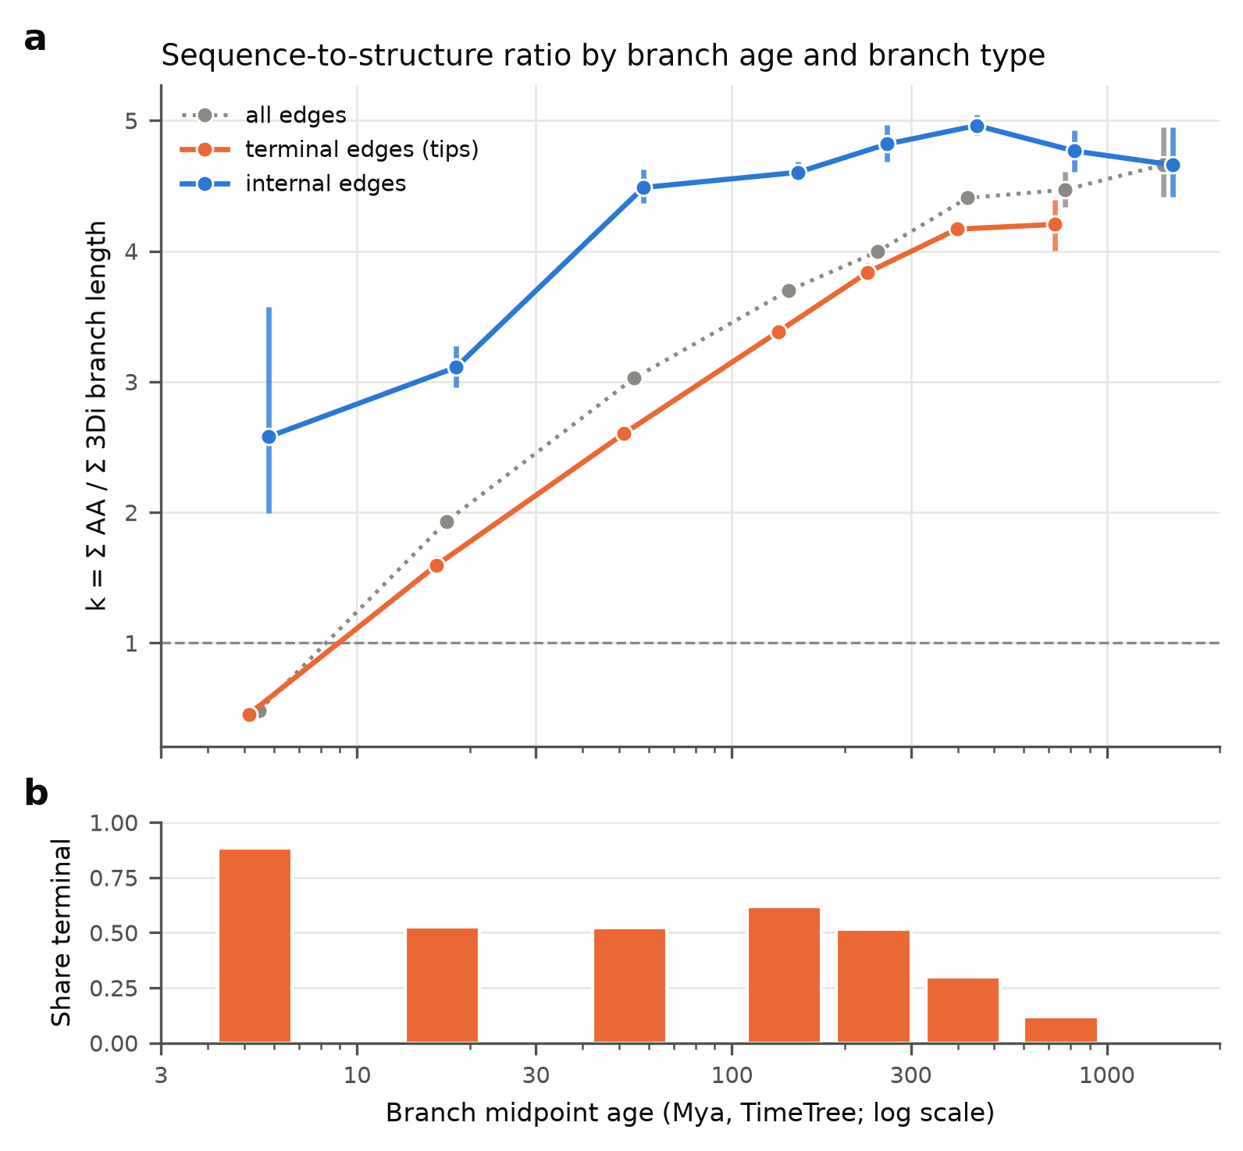
H3 · Time: is the structure/sequence ratio constant?
Prior work
Zuckerkandl & Pauling 1965; Kimura 1968 (neutral clock); Pascual-García 2019 vs Moi 2025 (mixed evidence).
+ Pros
− Cons
dated species tree
alternative deep timescales
terminal vs internal split
only 224 young families
deep dates uncertain
tip-correction sensitive
Pre-registered
Ratio rises with age (p_Holm 3×10⁻¹²), robust to α and timescale
Post hoc (verified)
Age trend = terminal-branch noise artefact; internal ratio flat ≈4.6 from 30 My to >1 Gy
Ratio k by branch age (TimeTree), split into terminal (species tips) and internal branches.
Notes:
E4. The slope tracks the size of the tip correction almost linearly and vanishes near 0.036; internal branches give −0.047, n.s.

Slide 31
H4 · Lineages: is there a neutral structural clock?
Prior work
Ohta 1973 (nearly neutral); Bromham & Penny 2003 (rate variation); Pascual-García 2019 (structural clock violations).
+ Pros
− Cons
sister-lineage contrasts
spike-in power test
guards against artefacts
power only 24%
accepting the null practically unreachable
Pre-registered
Artefact-suspect: excess vanishes on internal branches
Post hoc (verified)
No robust lineage-specific structural rates; neutrality not testable with this design
Do some lineages change structure faster than their sequence change predicts?
Notes:
E5. Margins were not widened after seeing the low power.

Slide 32
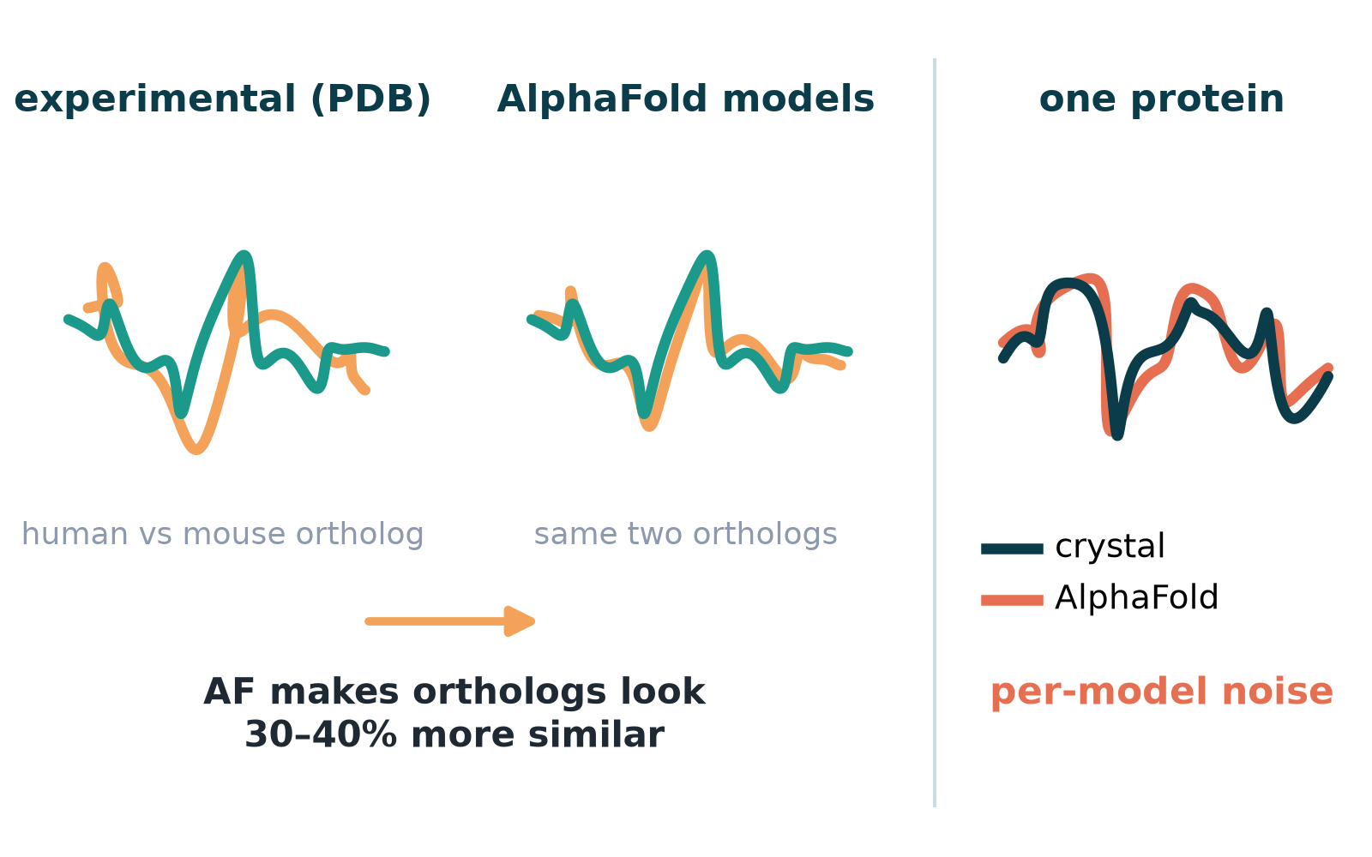
H5 · Do AlphaFold models make orthologs look too similar?
Prior work
Jumper et al. 2021; Buel & Walters 2022 and Pak et al. 2023 (AF insensitive to point mutations).
+ Pros
− Cons
identical residue sets
post-training-cutoff structures
197 post-cutoff pairs
few deep pairs
crystal conditions add own noise
Exploratory
AF–AF divergence = 0.59× PDB–PDB for 3Di
Same ortholog pairs and same residues: AlphaFold vs experimental (PDB) structures.
Notes:
X4. Bias is a roughly constant offset, not growing with divergence. A model vs its own crystal structure differs more (0.24) than two ortholog models (0.17).

Slide 33
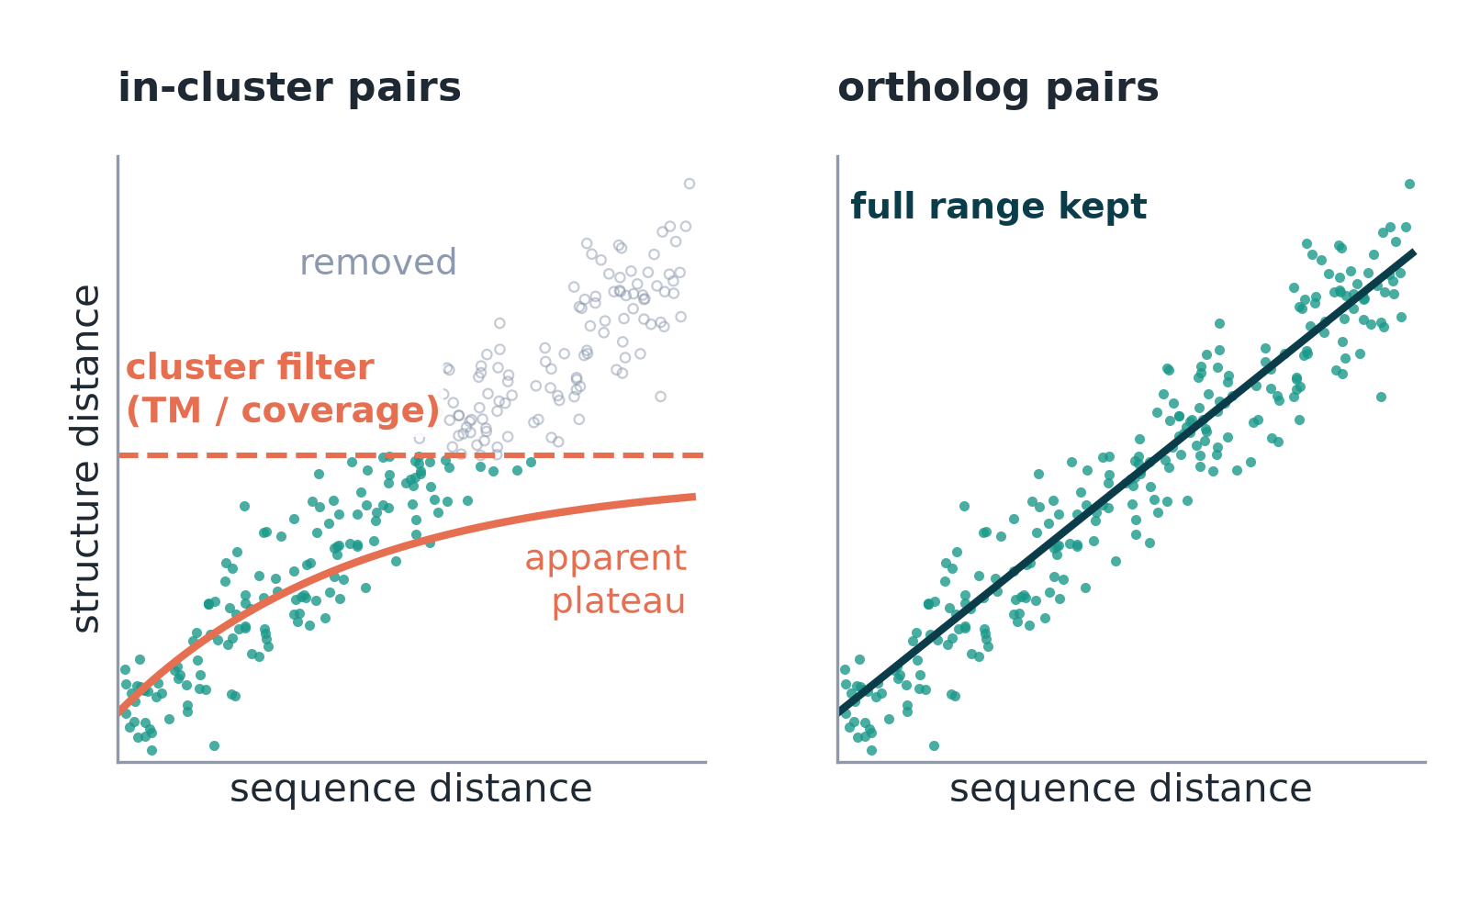
H6 · Do structural clusters hide divergent pairs?
Prior work
Barrio-Hernandez et al. 2023 (clustering: 90% coverage, E < 0.01).
+ Pros
− Cons
27.7 M cluster pairs vs our orthologs
same metrics
ranges barely overlap (10–35% vs 47–99% identity)
scoring differs
Exploratory
in-cluster TM plateaus ≈0.83 = prediction-quality ceiling
Pairs inside AFDB clusters passed a structural filter; ortholog pairs did not.
Notes:
X7 / P-clu. The plateau tracks representative pLDDT and length rather than evolutionary saturation.

Slide 34
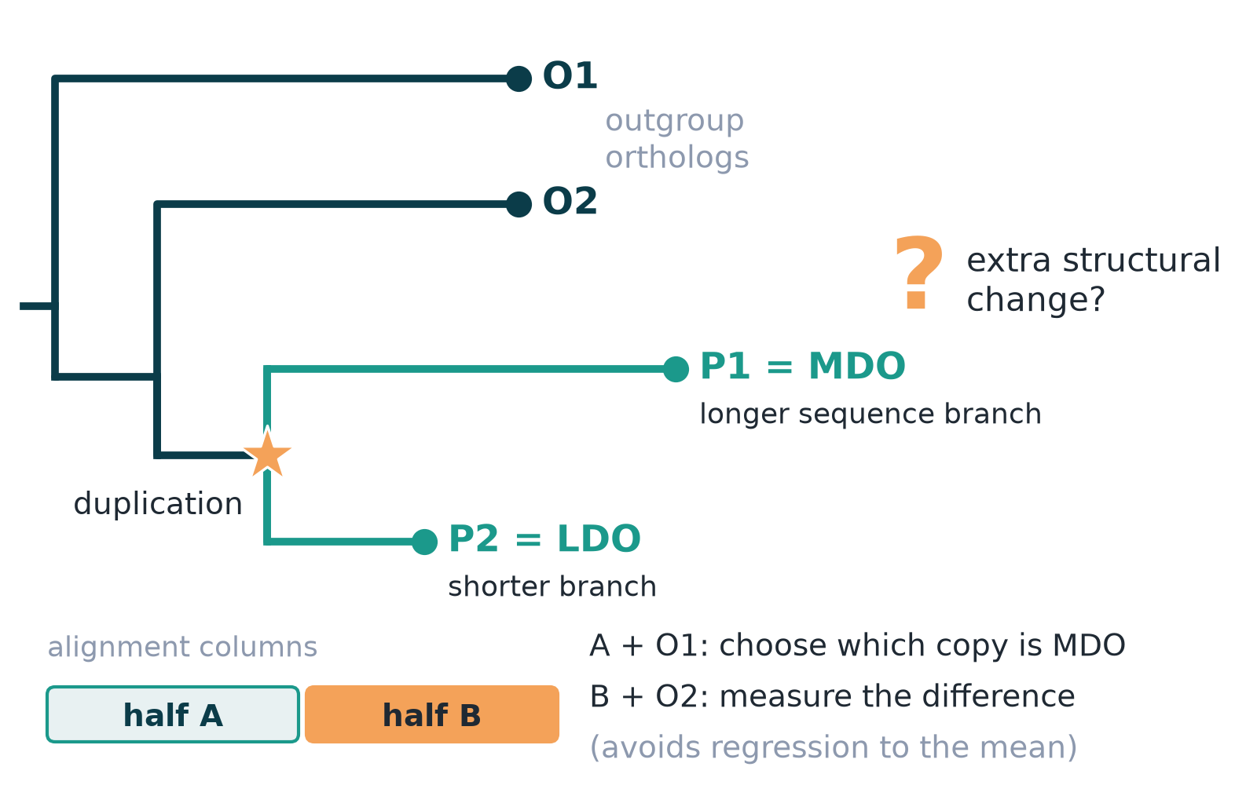
H7 · Duplication: do paralogs diverge more in structure?
Prior work
Ortholog conjecture: Nehrt et al. 2011, Altenhoff et al. 2012; LDO: Warwick Vesztrocy et al. 2025.
+ Pros
− Cons
design avoids regression to the mean
3,525 families
paralog part not alignment-robust
effect ~ size of per-model noise
Pre-registered
Detected: paralog excess 0.030; faster copy +0.017
Post hoc (verified)
Faster-copy excess halves after pLDDT adjustment (0.011) but stays positive; direction replicates
Positive control and least-diverged-ortholog (LDO) test with split alignment columns.
Notes:
E6. Direction of the published result replicates; biological size uncertain.

Slide 35
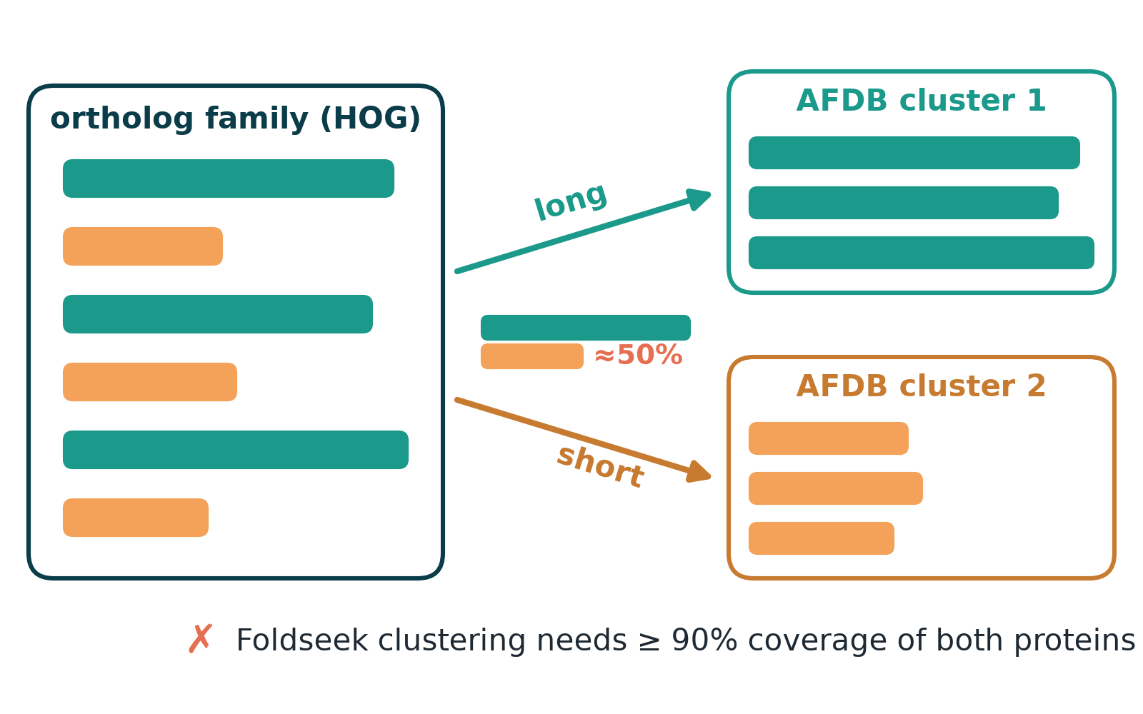
H8 · Are AFDB structural clusters ortholog groups?
Prior work
Barrio-Hernandez et al. 2023 (cluster ages by last common ancestor); TED domains (Lau et al. 2024).
+ Pros
− Cons
all families
logistic model of splits
Ancestra orthology itself unverified
domain labels noisy (21–25%)
Exploratory
70% of groups split across clusters
Map 109,598 ortholog groups onto AFDB structural clusters.
Notes:
X5. Length ratio dominates (log-odds 4.06 per SD); domain architecture adds nothing once length is in. Cluster ages agree exactly with orthology ages in only 27%.

Slide 36
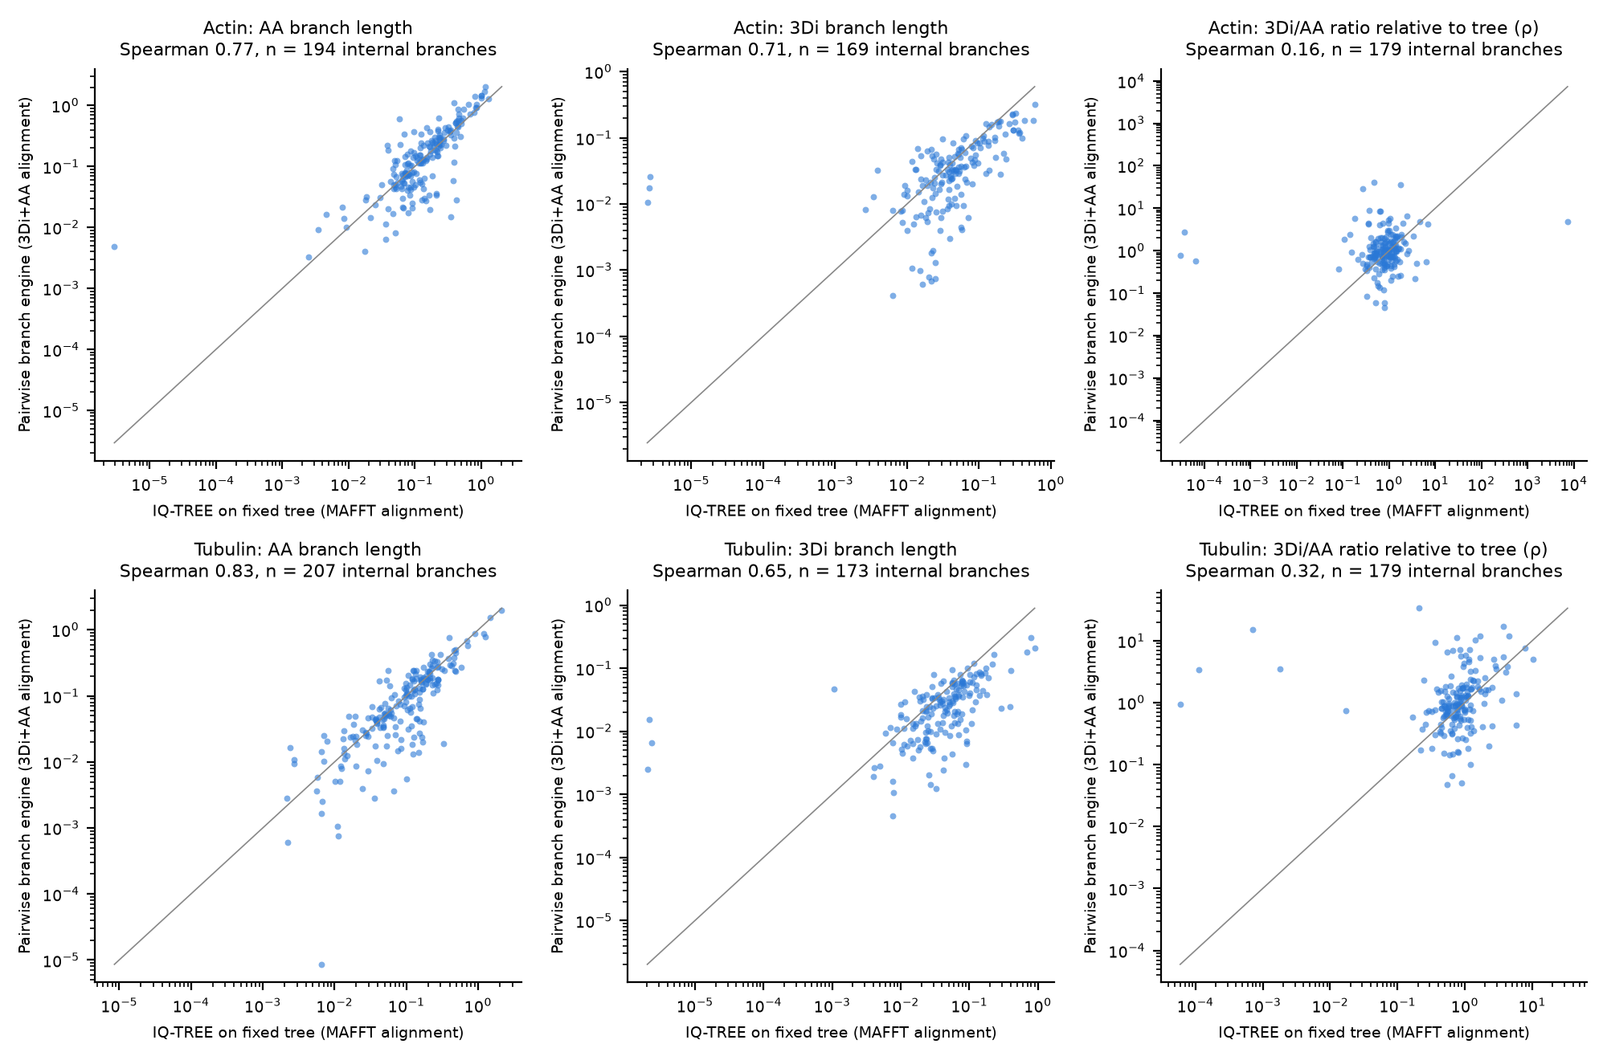
H9 · Case studies: bursts of structural change?
Prior work
Prokaryotic cytoskeleton homologs (MreB, FtsZ), Asgard archaea; kinase evolution (Kannan & Taylor).
+ Pros
− Cons
fixed reference trees
3 alignments
two estimators
per-branch ratios disagree between methods
deep sequence saturation
Exploratory
no robust stem bursts
Actin/tubulin folds (with prokaryotic & Asgard homologs) and protein kinases.
Notes:
X6 / X8. Tyrosine-kinase origin shows a weak, consistent excess (88–91st percentile); not a burst.

Slide 37
Results and take-home messages
6
What the pre-registered tests said, and what survived scrutiny

Slide 38
Scorecard: pre-registered vs post-hoc reading
Question | Pre-registered (confirm set) | Best reading
Shape (E1/E2) | concave, ĉ 0.72 | 0.75–1.0: near-proportional
Ratio (E3) | 3.3× (α 4.7, β 2.6) | 4.6× on internal branches
Time (E4) | ratio rises with age | flat 30 My – >1 Gy (tip artefact)
Lineages (E5) | artefact-suspect | no robust lineage effects
Duplication (E6) | detected | direction robust; size ~halved
AlphaFold bias (X4) | — | orthologs look 30–40% more similar
Clusters vs orthology (X5) | — | 70% of groups split, by length
Notes:
Pre-registered decisions are reported unchanged. Post-hoc readings were checked by an independent agent that tried to refute them.

Slide 39
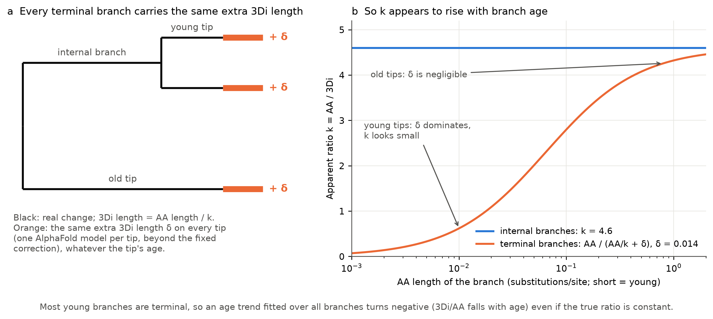
The twist: one hidden noise source explains most signals
Bends E1 toward concave
Creates E4 age trend
Fakes E5 lineage effects
Notes:
Each AlphaFold model carries a small protein-specific structural offset (~0.01–0.017 3Di substitutions per site, larger at low confidence). Pre-registered floors from identical sequences missed it. It sits on terminal branches: young branches look structurally 'fast', which bends curves and creates an age trend.

Slide 40
What is new, and how it relates to the literature
Confirmed
Refined
New
Structure changes more slowly than sequence (Illergård 2009): 3–5×
β-rich folds change structure faster than α (Illergård 2009)
Direction of the LDO structural result (Warwick Vesztrocy 2025)
'Linear' holds roughly, now on matched 20-state models and thousands of families
Structure is proportional to sequence on a real time axis (30 My – >1 Gy, internal branches)
Structural clock violations not robust once artefacts handled
AlphaFold homogenises orthologs (30–40% more similar than crystals)
Per-model 3Di noise inflates terminal branches
AFDB clusters split ortholog groups, mostly by length
Notes:
Green: confirmed prior claims. Amber: refined. Coral: new observations from this project.

Slide 41
Take-home messages
≈4.6×
0.75–1.0
sequence changes faster than 3Di structure (internal branches)
curvature: structure roughly proportional to sequence, mild saturation at most
30–40%
70%
AlphaFold makes orthologs look more alike than experiments
of ortholog groups are split across AFDB structural clusters
Notes:
Four numbers to remember.

Slide 42
Decision making and the future
7
What transfers to the next AI-led project

Slide 43
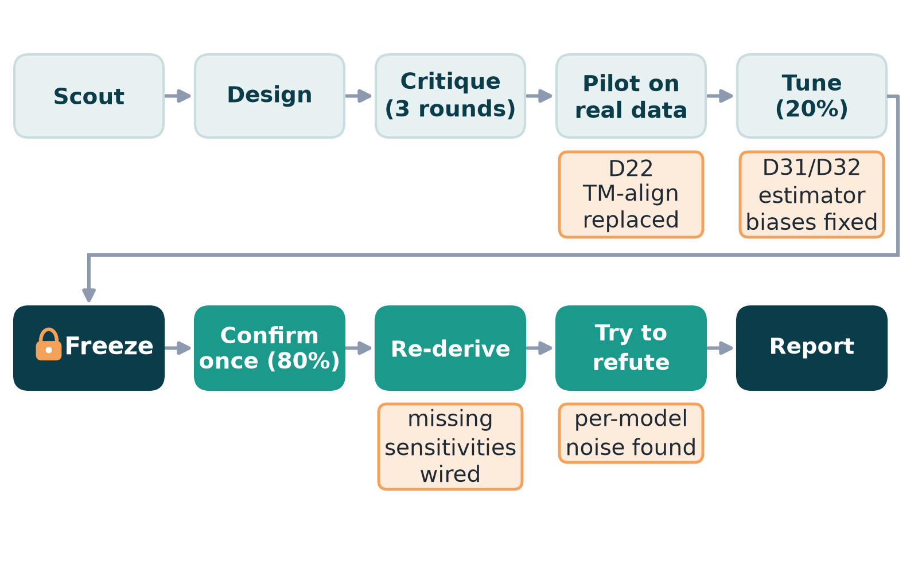
The decision loop, and where it changed course
Notes:
Amber callouts mark where a step changed the plan: pilot (D22), synthetic tests (D31/D32), dry run (missing sensitivities), and the post-hoc refutation (per-model noise).

Slide 44
What worked, and what did not
Worked
Did not
Parallel scouting before design
Small real pilot before freezing
Synthetic worlds with known answers
Pre-registration + deviation log
Independent re-derivation and refutation attempts
Research tree as memory across a node move
Noise floor from a single control type
Plan-specified sensitivities unwired until the dry run
Exploratory work competing with the critical path
Reviewers shared blind spots (same model family)
Harness quirks: blocked file writes, self-matching wait loops
Notes:
From the milestone retrospectives and LESSONS.md.

Slide 45
Carrying the decision process to future projects
1
Scout data, tools and literature in parallel before designing
2
Pilot the whole pipeline on small real data before freezing
3
Test every estimator on synthetic truths, incl. nuisance noise
4
Validate noise floors with two independent controls
5
Freeze, confirm once, log every deviation
6
Ask a fresh agent to refute surprising conclusions
Notes:
Rules distilled from this project's LESSONS.md.

Slide 46
Conclusion: AI-led research
In ~23 compute hours an AI team designed, pre-registered, ran and verified a study of 1.4 M protein pairs, and corrected its own headline.
Limits: shared blind spots across agents; no human verification yet; predicted structures only.
Next: human audit · AlphaFold runs with varied MSA depth · PDB same-protein floors · time-calibrated structural phylogenetics · agentic labs at scale
Notes:
Close on the two-sided message: the AI-led process was fast, transparent and self-correcting, but its conclusions still need human verification.

Slide 47
Acknowledgements and open slots
To fill in
Resources used
Hackathon dates and participants: [__]
Human contributors / project lead: [__]
Project repository link: [__]
Verification status by humans: [pending]
AlphaFold DB & AFDB clusters (Steinegger, Beltrao labs; CC-BY 4.0)
Foldseek, FoldMason, Q.3Di.AF
Ancestra (hackathon Phase 1)
TimeTree (data not redistributed)
UniProt, PDB/SIFTS, TED, Pfam
Notes:
Fill these before presenting.

